Slide 1
Cloud migration and Design - Case Studies
CS 4037 – Introduction to Cloud Computing
FAST-NUCES

Slide 2
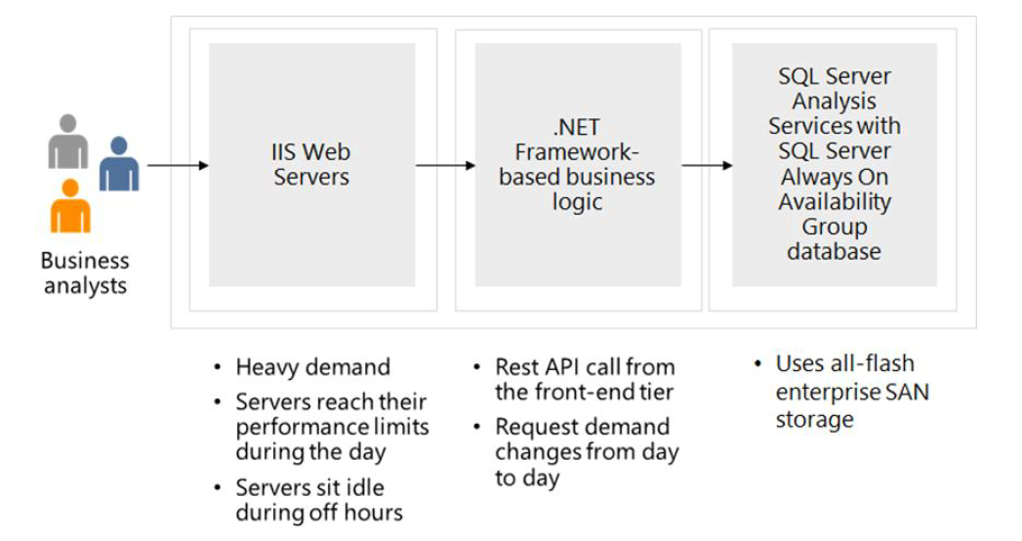
Design Compute Case

Slide 3
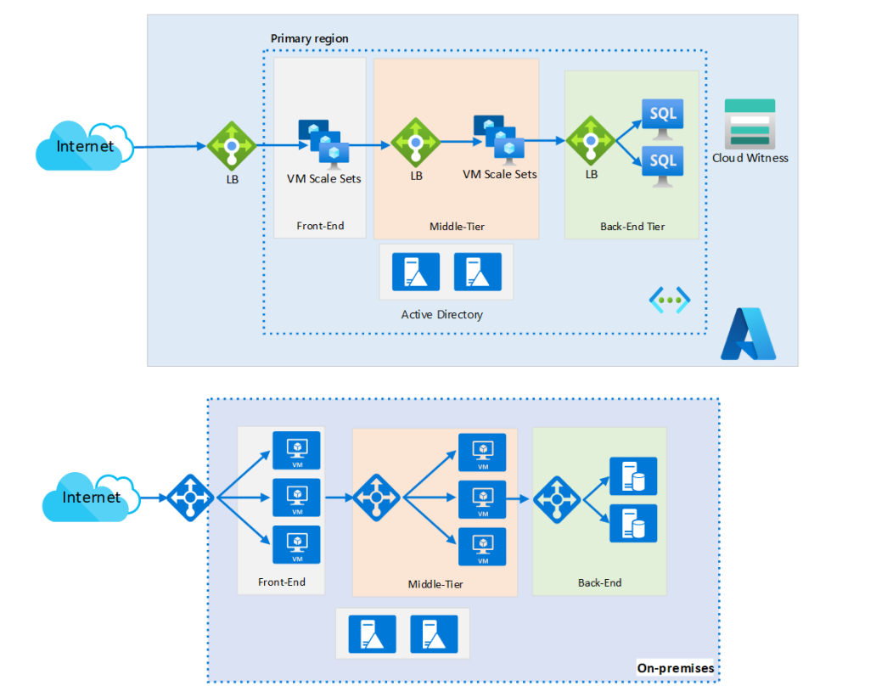
IaaS Solution

Slide 4
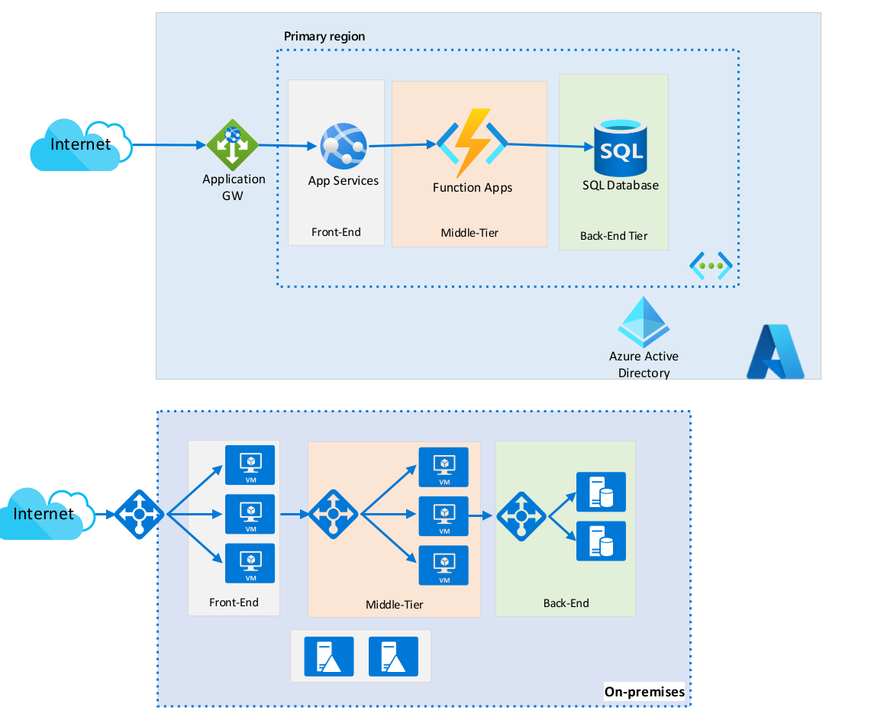
PaaS Solution

Slide 5
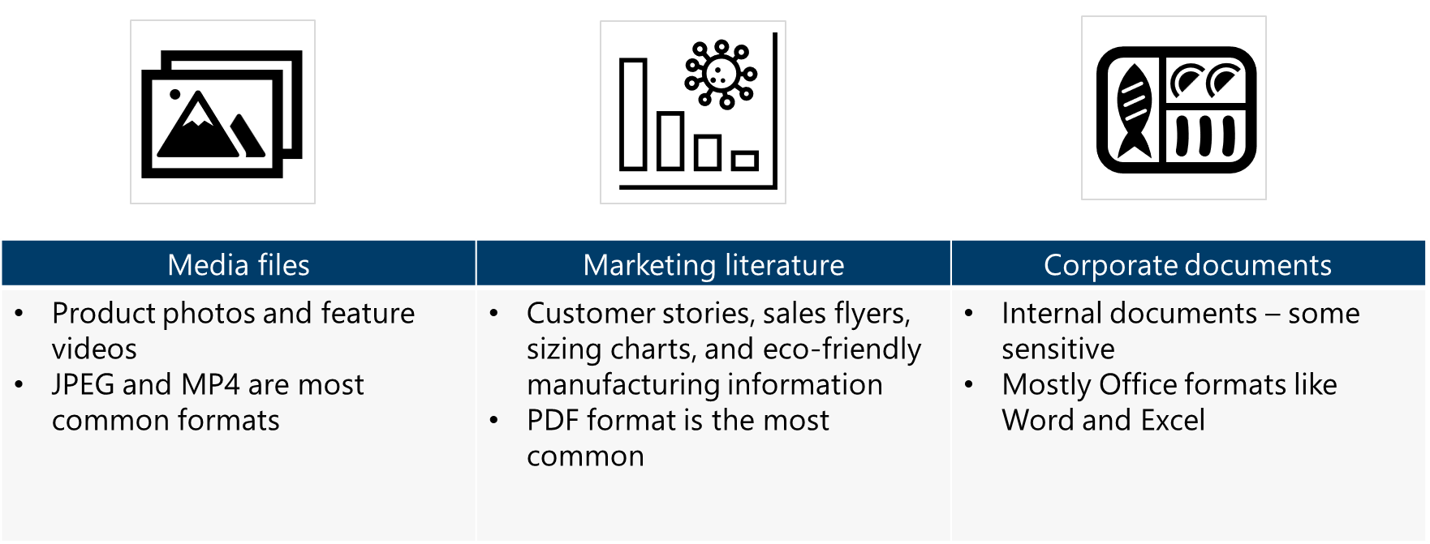
Design Non-relational Storage Case Study
Requirements:
Tailwind Traders wants to reduce storage costs by reducing duplicate content and, whenever applicable, migrating it to the cloud. They would like a solution that centralizes maintenance while still providing world-wide access for customers who browse media files and marketing literature. Additionally, they would like to address the storage of company data files.

Slide 6
Blob storage is recommended for the media and corporate files. Blob storage is less expensive, offers the immutable storage requirements for legal, and supports API access for internal applications.
Azure Files is recommended for the marketing literature. Azure Files is needed for marketing since the files will be accessed via SMB internally.
Marketing literature access latency for internal users could be reduced by using a local Windows Server and File Sync
Design Non-relational Storage Case Study

Slide 7
Zone redundant storage is recommended. An argument could be made for Geo-redundant zone storage if the files are mission critical.
Read access geo-redundant storage could be used if the front end could make use of a secondary region.
This decision would depend on the customer’s locations and traffic.
The hot tier should be used for all media, marketing literature and corporate documents less than one year old. The archive tier or cold tier should be used for corporate documents older than one year.
This decision is based on retrieval latency, storage duration and a desire to reduce costs.
Discuss that there is not enough information to decide between Cold and Archive and ask what other questions they may want to ask Tailwind Traders.
Lifecycle management should be used to convert corporate documents to a cheaper storage tier after one year.

Slide 8
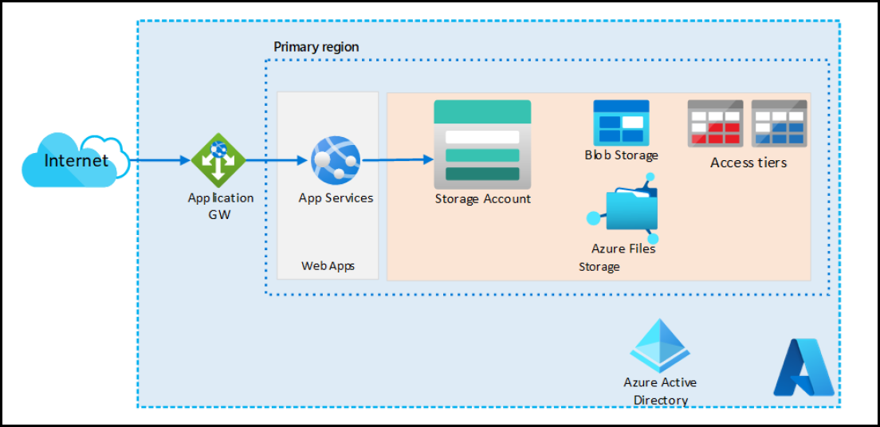

Slide 9
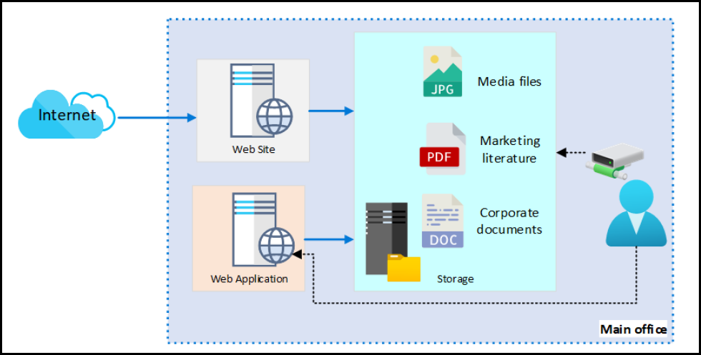

Slide 10
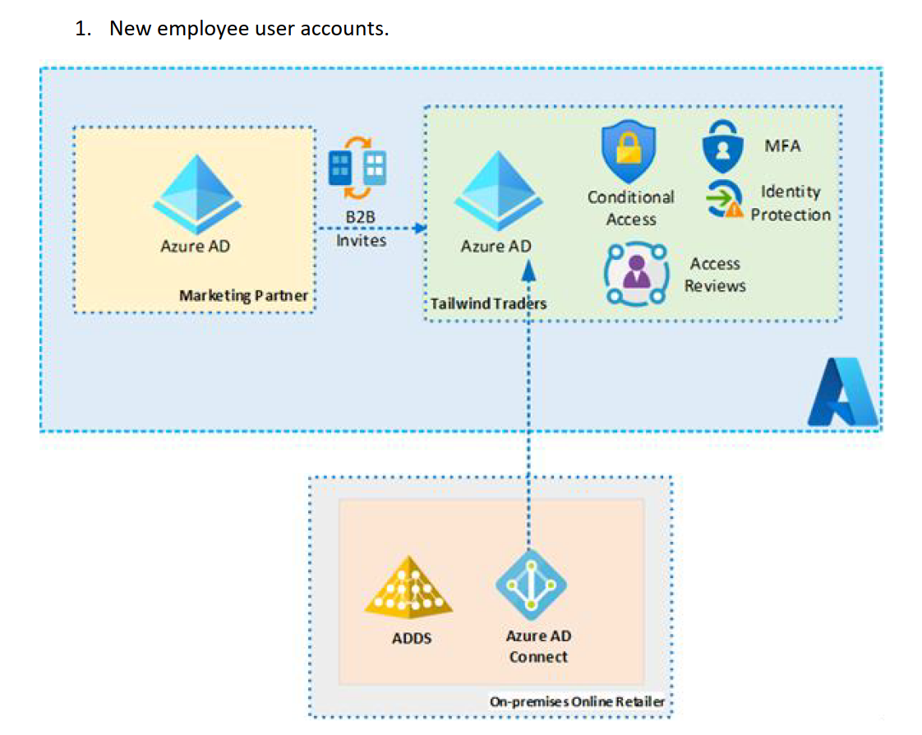
Design authentication and authorization solutions

Slide 11
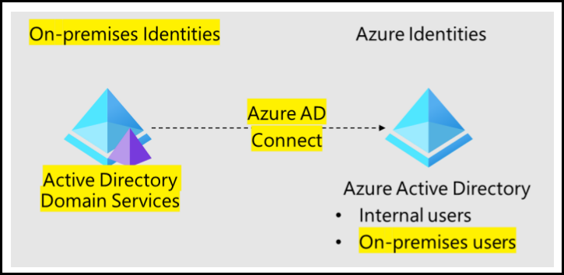
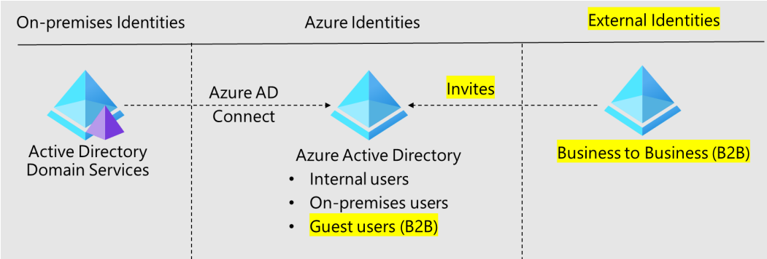

Slide 12
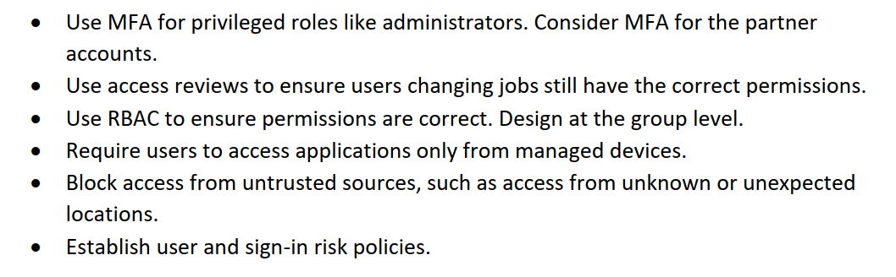
New Identity Solution Features

